Slide 1

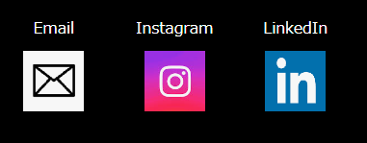
Home
Mobile
Mockup
Sho Yoshimura
Project
Skills
Work Experience
Contact Me
Sho Yoshimura
My
Picture
I’m an Electric Engineer → Web Developer
I have diploma of Electric Information Technology, and I was working in semiconductor industry. I’m good at suggesting efficiency and removing waste of process. I worked with Chinese, Taiwanese, and American people in Chinese and English. I was getting along with them and worked together. I’m learning HTML/CSS, JS to become a Web Developer that can provide Efficient systems.
I’m an active person
I really like Nature, which is Mountain, river, sea,,, and sports. I’ve done these sports, Soccer, Handball, Tennis, Bouldering, Judo and so on. I have scuba diving license and Judo Black belt. I’m going to do Judo Canada in the future. Honestly, I’m not good at doing sports, but I really love and enjoy nature and sports. Let’s enjoy together!!

Slide 2
Home
Tablet
Mockup
Sho Yoshimura
Project Skills Work Experience Contact Me
Sho Yoshimura
I’m an Electric Engineer → Web Developer
I have diploma of Electric Information Technology, and I was working in semiconductor industry. I’m good at suggesting efficiency and removing waste of process. I worked with Chinese, Taiwanese, and American people in Chinese and English. I was getting along with them and worked together. I’m learning HTML/CSS, JS to become a Web Developer that can provide Efficient systems.
My
Picture
I’m an active person
I really like Nature, which is Mountain, river, sea,,, and sports. I’ve done these sports, Soccer, Handball, Tennis, Bouldering, Judo and so on. I have scuba diving license and Judo Black belt. I’m going to do Judo Canada in the future. Honestly, I’m not good at doing sports, but I really love and enjoy nature and sports. Let’s enjoy together!!

Slide 3
Home
PC
Mockup
Sho Yoshimura
Project Skills Work Experience Contact Me
Sho Yoshimura
I’m an Electric Engineer → Web Developer
My
Picture
I have diploma of Electric Information Technology, and I was working in semiconductor industry. I’m good at suggesting efficiency and removing waste of process. I worked with Chinese, Taiwanese, and American people in Chinese and English. I was getting along with them and worked together. I’m learning HTML/CSS, JS to become a Web Developer that can provide Efficient systems.
I’m an active person
I really like Nature, which is Mountain, river, sea,,, and sports. I’ve done these sports, Soccer, Handball, Tennis, Bouldering, Judo and so on. I have scuba diving license and Judo Black belt. I’m going to do Judo Canada in the future. Honestly, I’m not good at doing sports, but I really love and enjoy nature and sports. Let’s enjoy together!!

Slide 4
Project
Mobile
Mockup
Project
Title
Title
My
Picture
My
Picture
Title
Title
My
Picture
My
Picture
Title
Title
My
Picture
My
Picture
Show more

Slide 5
project
Tablet, PC
Mockup
Project
Title
Title
Title
My
Picture
Link
My
Picture
My
Picture
Title
Title
Title
My
Picture
My
Picture
My
Picture
Show more

Slide 6
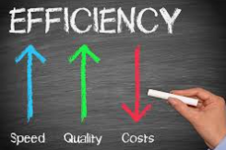

Skills
Mobile
Mockup
Skills
Realize Efficiency
I’m good at thinking and providing great way to remove waste of process, factory lines.
HTML
I can create web systems. I can provide the ideal web site.
Show more

Slide 7

Skills
Tablet,PC
Mockup
Skills
Realize Efficiency
HTML
JS
I’m good at thinking and providing great way to remove waste of process, factory lines.
I can create web systems. I can provide the ideal web site.
I can make codes with JS and I’m learning JS as a student. I’m going to collaborate with my efficiency skill, then I’d provide great systems.
Show more

Slide 8
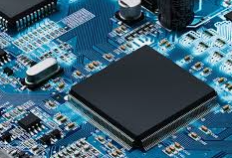
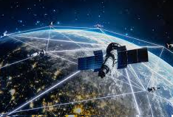
Work Experience
Mobile
Mockup
Work Experience
Semiconductor
I worked a Japanese semiconductor company for 13 years as an Engineer. I had experiences of Production, Efficient and Service Engineering.
Satellite Communication
I’m working the company which creating Satellite Communication products in Canada. I usually do testing of products and trouble shooting. I’m gaining experience working in Canada.
Show more

Slide 9
Work Experience
Tablet,PC
Mockup
Work Experience
Semiconductor
Satellite Communication
I worked a Japanese semiconductor company for 13 years as an Engineer. I had experiences of Production, Efficient and Service Engineering.
I’m working the company which creating Satellite Communication products in Canada. I usually do testing of products and trouble shooting. I’m gaining experience working in Canada.
Show more

Slide 10
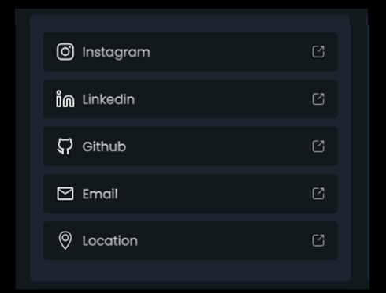
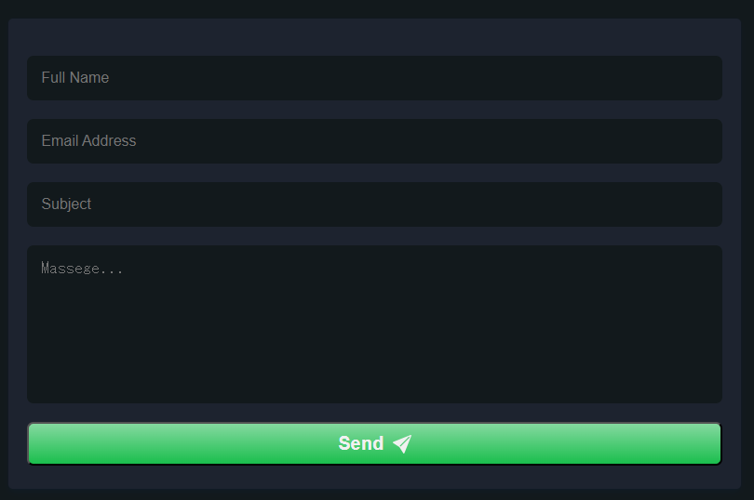
Contact Me
Mobile
Mockup
Contact Me

Slide 11
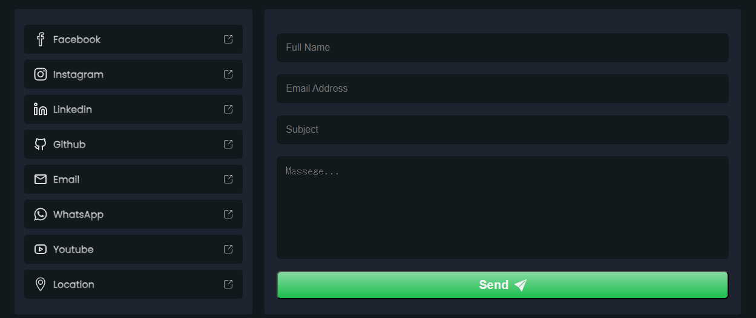
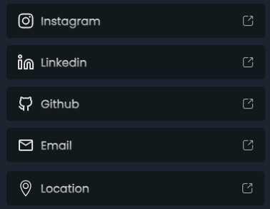
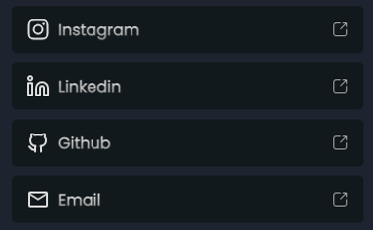
Contact Me
Mobile
Mockup
Contact Me

Slide 12
Footer
Mobile, Tablet and PC
Mockup
Sho Yoshimura
Sho Yoshimura

